Slide 1
Audio and speech processing
Machine Learning Summer School 2021
Kateřina Žmolíková

Slide 2
1. Introduction

Slide 3

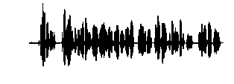
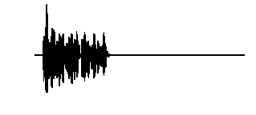
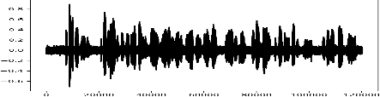

Tasks in audio and speech processing
Speech recognition
Hello.
Speaker recognition
Alice
Speech synthesis
Hello.
Speech enhancement
and much more (speech coding, diarization, voice conversion, disease detection…)

Slide 4
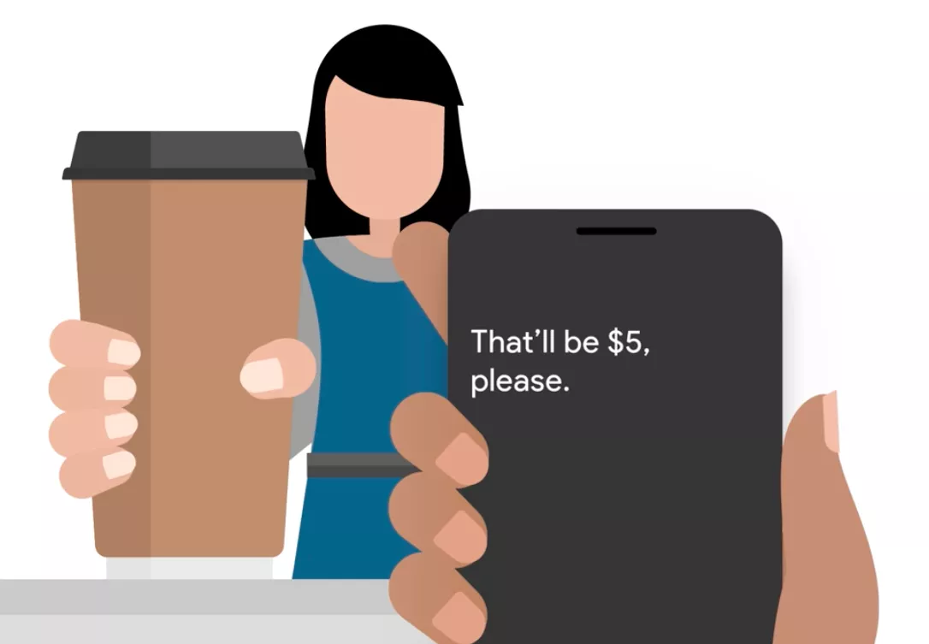
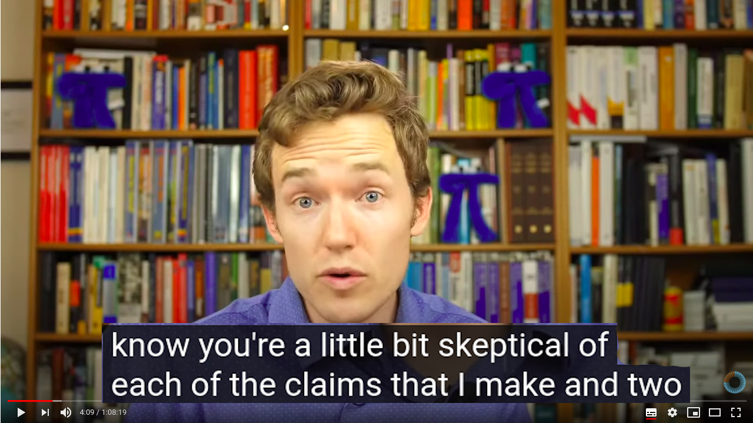
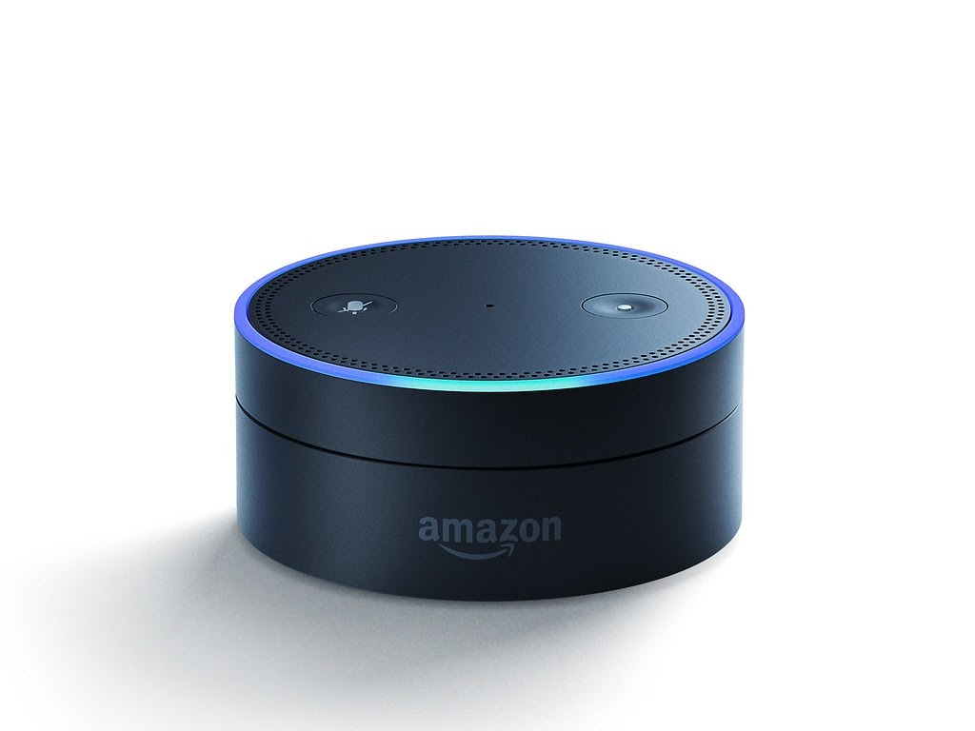
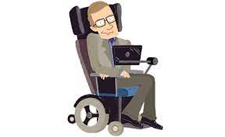
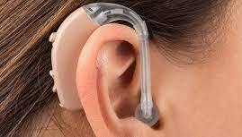
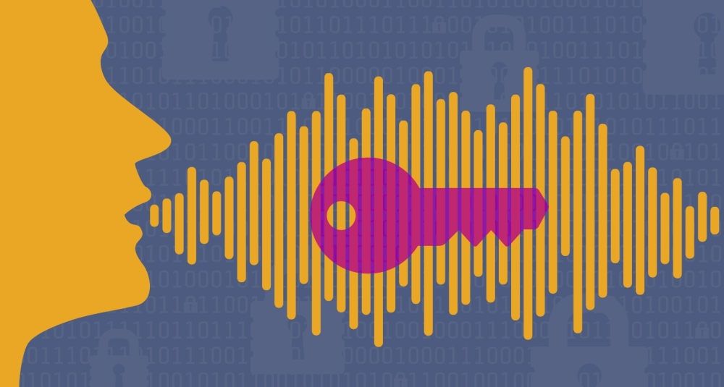
What for?
Virtual assistants
Live transcription
Video subtitles
Voice authentication
Voice aid devices
Hearing aid devices
and much more!

Slide 5
Relation to other machine learning tasks
What is special about speech compared to images?
Sequential data
Left-to-right dependency
What is special about speech compared to text?
Continuous values
Longer sequences

Slide 6
2. Speech signal

Slide 7
Speech signal: production
https://www.youtube.com/watch?v=SVKR3ESdAk8
Notes:
In other languages than English, there might be sounds produced differently (e.g. not using air from lungs, produced by air incoming into the lungs…)
10-12 phonemes per second

Slide 8
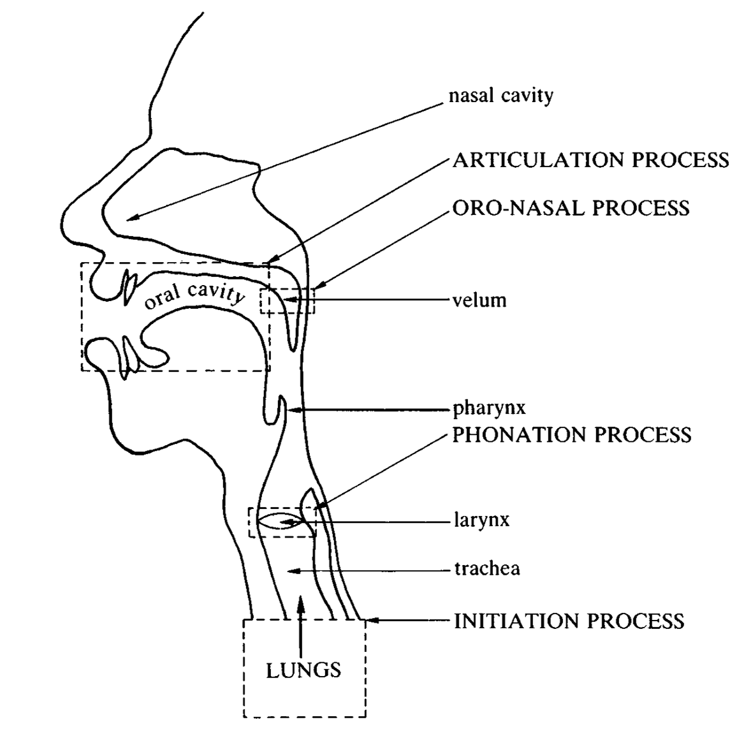
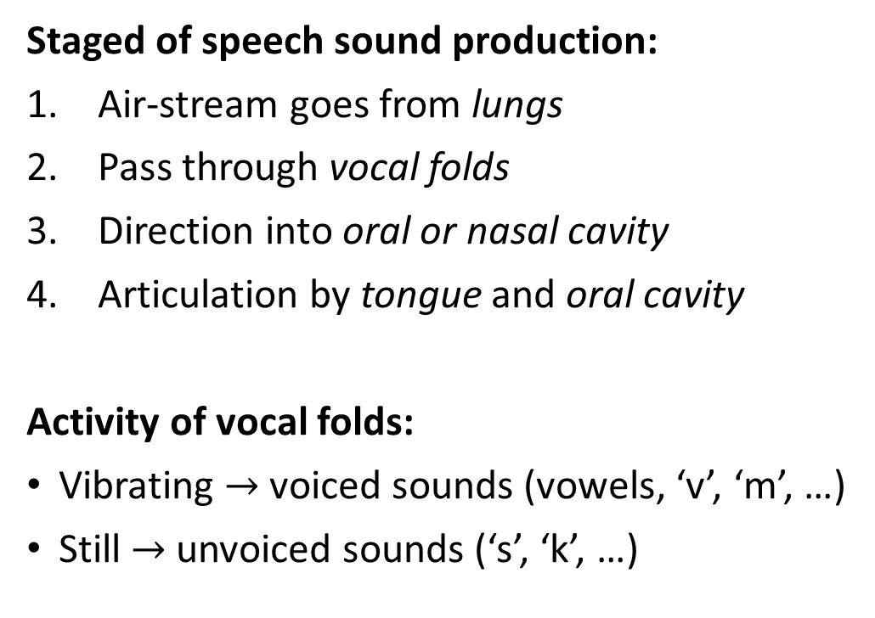
Speech signal: production
Staged of speech sound production:
Air-stream goes from lungs
Pass through vocal folds
Direction into oral or nasal cavity
Articulation by tongue and oral cavity
Activity of vocal folds:
Vibrating $→$ voiced sounds (vowels, ‘v’, ‘m’, …)
Still $→$ unvoiced sounds (‘s’, ‘k’, …)
Also try: https://dood.al/pinktrombone
Giegerich, H. (1992). Speech sounds and their production
Notes:
In other languages than English, there might be sounds produced differently (e.g. not using air from lungs, produced by air incoming into the lungs…)
10-12 phonemes per second

Slide 9
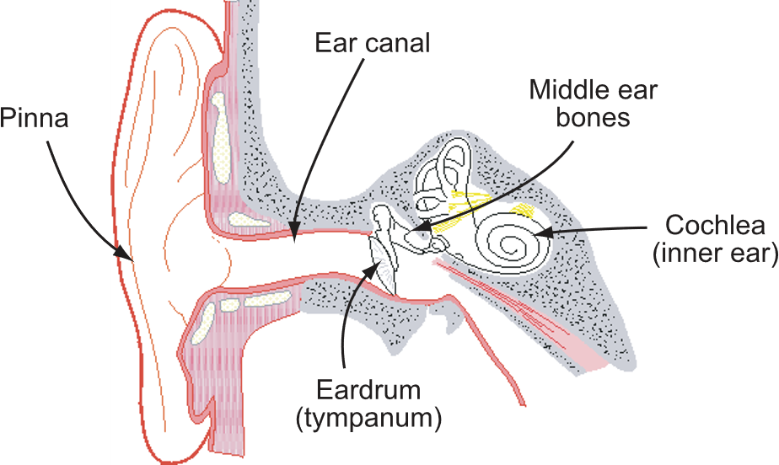
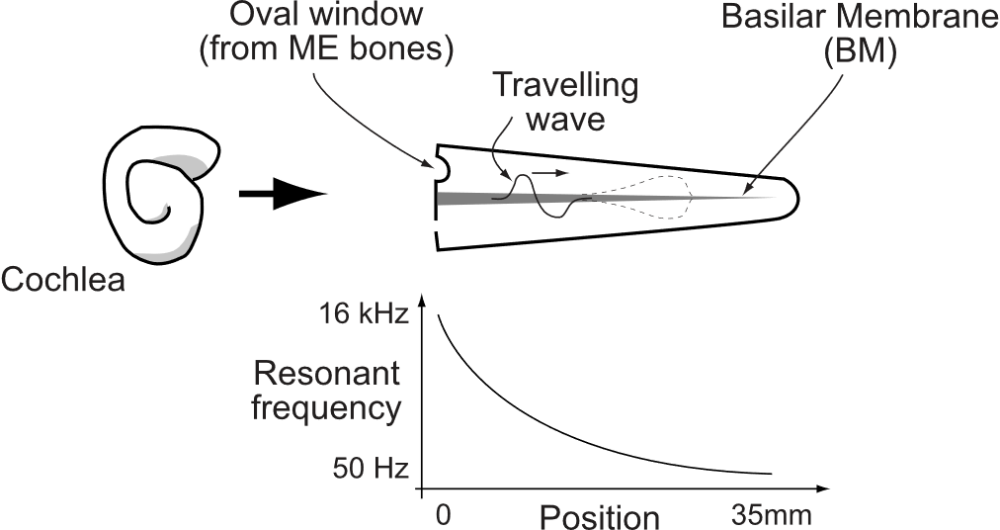
Speech signal: hearing
Outer ear: sound goes through pinna, ear canal to eardrum, which vibrates
Middle ear: three small bones (ossicles) transfer the vibrations from eardrum to cochlea
Inner ear: cochlea resonates at different places for different frequencies
hair cells transform vibrations into firings at auditory nerves
Mike Mandel, Dan Ellis: Auditory Perception https://www.ee.columbia.edu/~dpwe/e6820/lectures/L04-percep.pdf

Slide 10
Speech signal: hearing
https://www.youtube.com/watch?v=dyenMluFaUw

Slide 11
Speech signal: hearing
Some interesting properties of hearing
Higher frequency resolution on lower frequencies
Higher loudness resolution in lower loudness
Mike Mandel, Dan Ellis: Auditory Perception https://www.ee.columbia.edu/~dpwe/e6820/lectures/L04-percep.pdf

Slide 12

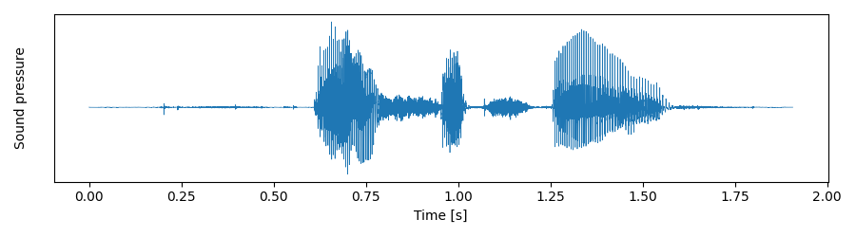
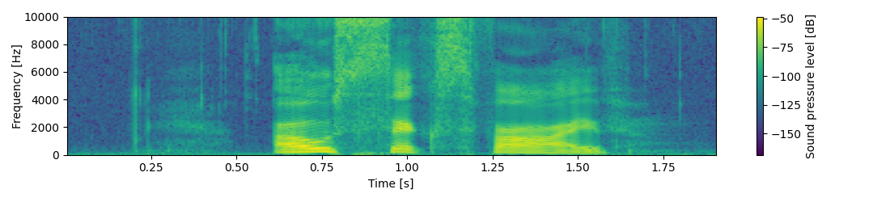
Looking at speech: time/frequency domain

Slide 13
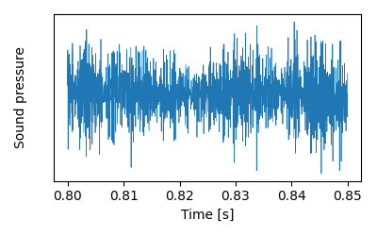
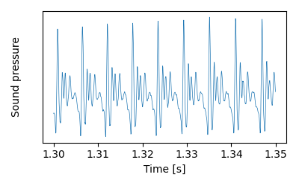
Looking at speech: time domain
s
a:

Slide 14
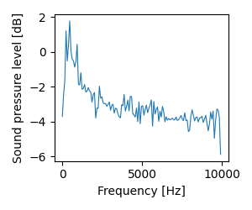
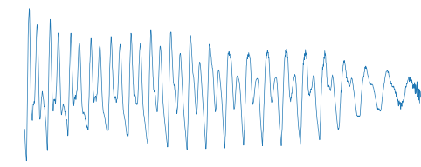
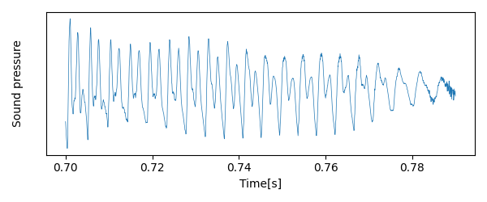
Looking at speech: frequency domain
What is spectrogram?
Frequency transformation

Slide 15
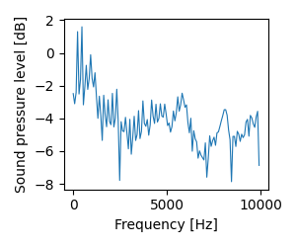
Looking at speech: frequency domain
What is spectrogram?
Frequency transformation

Slide 16
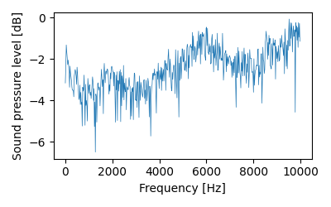
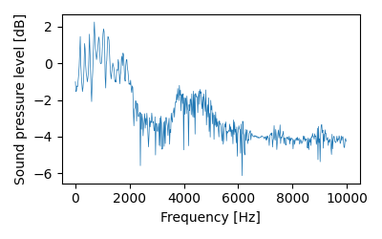
Looking at speech: frequency domain
s
a:

Slide 17
3. Speech features

Slide 18
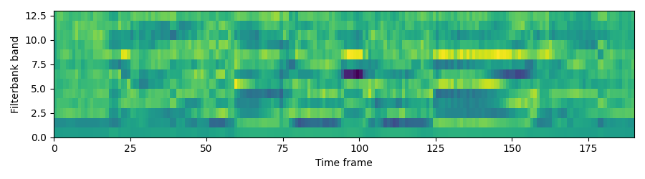
Goal of extracting features
Representing information in the speech signal which is relevant to the task
Discarding information irrelevant to the task
Discarding redundancies
Reducing dimensionality

Slide 19
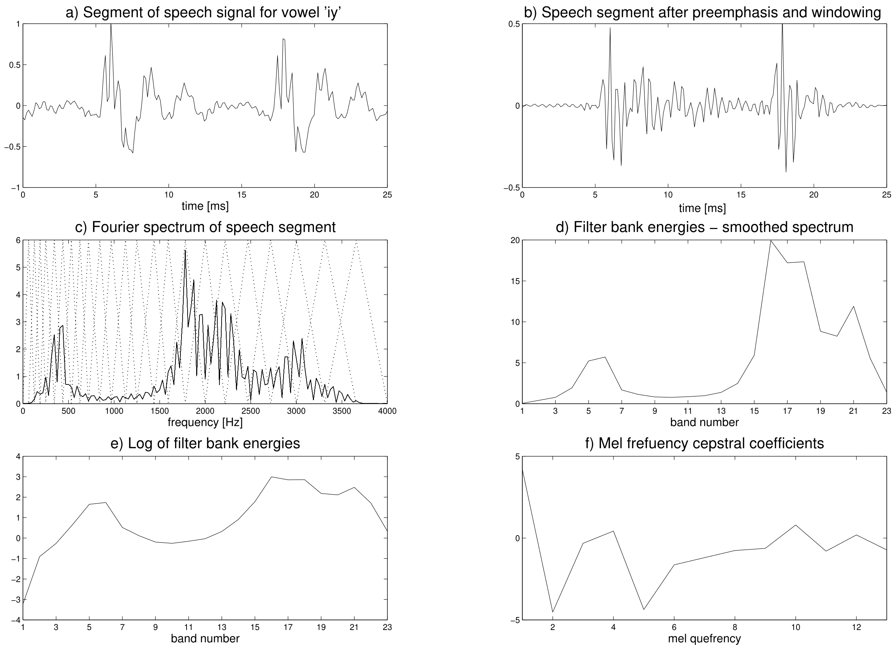
MFCCs = Mel frequency cepstral coefficients
Notes:
Filterbanks or log-filterbanks are also common!

Slide 20
4. Speaker verification

Slide 21
Task in speaker verification
Speaker verification
REJECT
Speaker verification
ACCEPT

Slide 22
Neural network-based approach
Train a neural network for speaker classification.
Forward test signals and extract vectors of hidden values (embeddings).
Compare the embeddings.
speaker1
Neural network
speaker2
speaker3
…
speakerN
Neural network
Neural network
similar enough?

Slide 23
Neural network for embedding extraction
frame-level
segment-level
Conv
ReLU
Conv
ReLU
Conv
ReLU
Linear
ReLU
Linear
Mean & std pooling
Linear
ReLU
Linear
Smax
fbank
embedding
Mean and standard deviation pooling
1st layer
convoution
2nd layer
convoution
3rd layer
convoution
mean
std

Slide 24
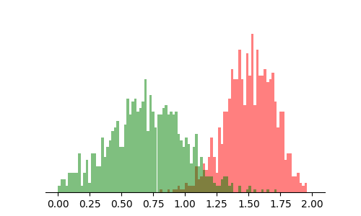
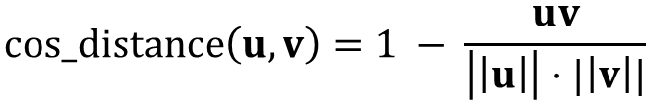



Comparing embeddings
similar enough?
Cosine distance
Histogram of scores
ACCEPT
REJECT
$$cos_distance\left(u,v\right)=1 − \frac{uv}{\left|\left|u\right|\right|⋅|\left|v\right||}$$
$$u$$
$$v$$
$$θ$$
threshold
How to choose?

Slide 25
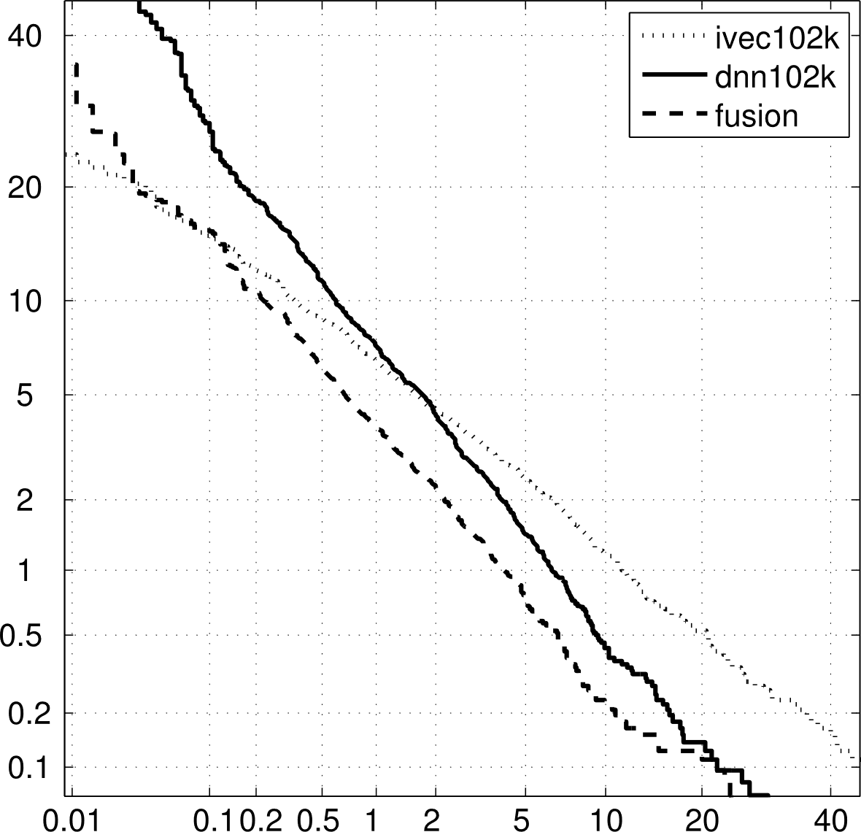
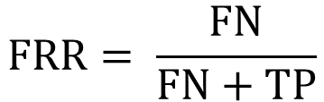
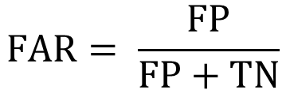
Evaluation of speaker verification
truth
DET curve
 | target | non-target
target | True positive (TP) | False positive (FP)
non-target | False negative (FN) | True negative (TN)
predicted
False reject rate (FRR)
$$FAR= \frac{FP}{FP+TN}$$
$$FRR= \frac{FN}{FN+TP}$$
False alarm rate (FAR)

Slide 26
Speaker diarization
Diarization = who speaks when?
segmentation + clustering
Steps
Extract embeddings from small chunks.
Cluster the embeddings.

Slide 27
Speech enhancement/separation

Slide 28
Speech enhancement/separation goal
Speech enhancement
Speech
separation

Slide 29
Neural network-based approaches
Neural networks
Inputs
Architectures
Time-domain
Convolutional
Recurrent
Challenges
Need of parallel data for training
Very noisy and reverberant data
Very long recordings (combination with diarization)
Frequency-domain

Slide 30
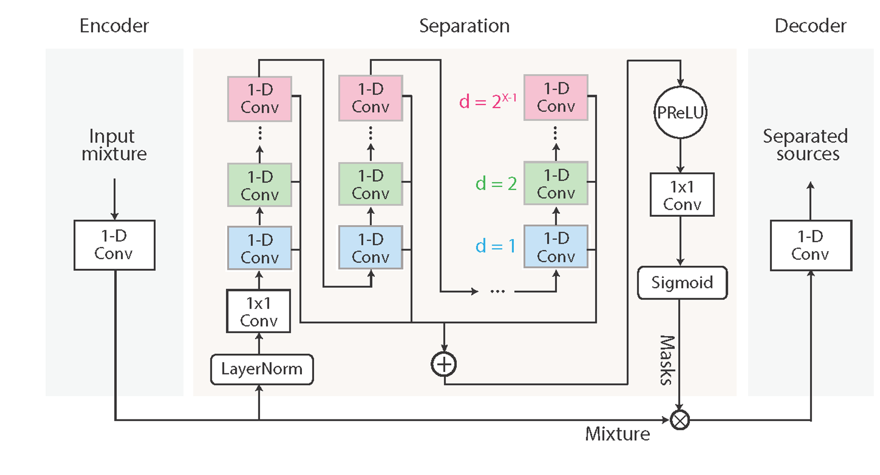
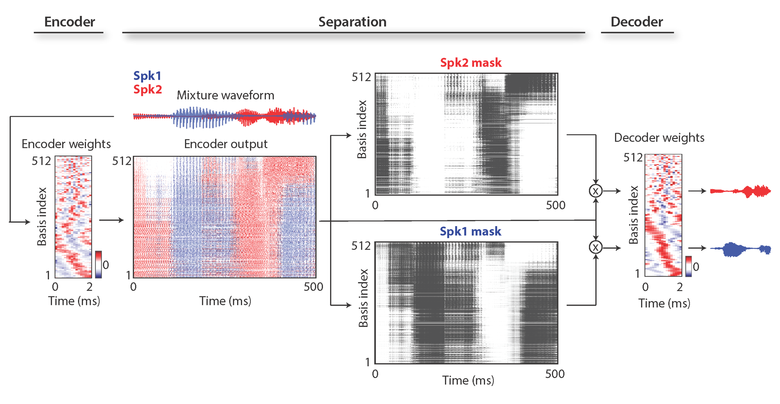
ConvTasnet

Slide 31
Examples of separated audios
2 speaker clean mixture
2 speaker noisy mixture
5 speaker mixture
Voice separation with an unknown number of multiple speakers, Nachmani et al
https://enk100.github.io/speaker_separation

Slide 32
Audio-visual approaches
https://www.youtube.com/watch?v=rVQVAPiJWKU

Slide 33



Multi-channel approaches
Signals from multiple microphones enable using spatial information
Similar to using two ears
Mostly done by signal processing technique beamforming

Slide 34
Speech synthesis

Slide 35
Task in speech synthesis
Speech synthesis
Hello.
Applications
Tools for people with visual impairment
Tools for people with voice impairment
Voice-bots
Automatic audiobooks
Entertainment – e.g. toys
Mechanical speaking machine (1769)
https://www.youtube.com/watch?v=k_YUB_S6Gpo

Slide 36
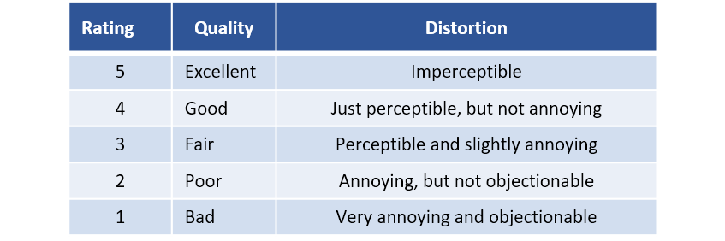
Evaluation of speech synthesis
Mean Opinion Score (MOS)

Slide 37
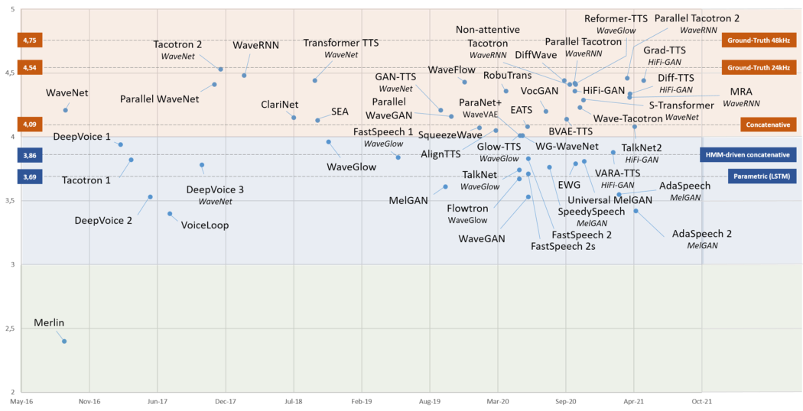
Techniques for speech synthesis

Slide 38
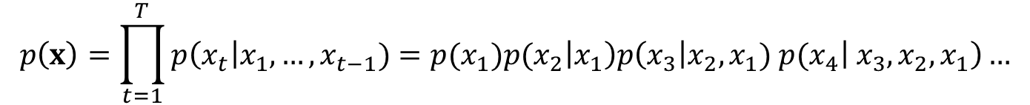
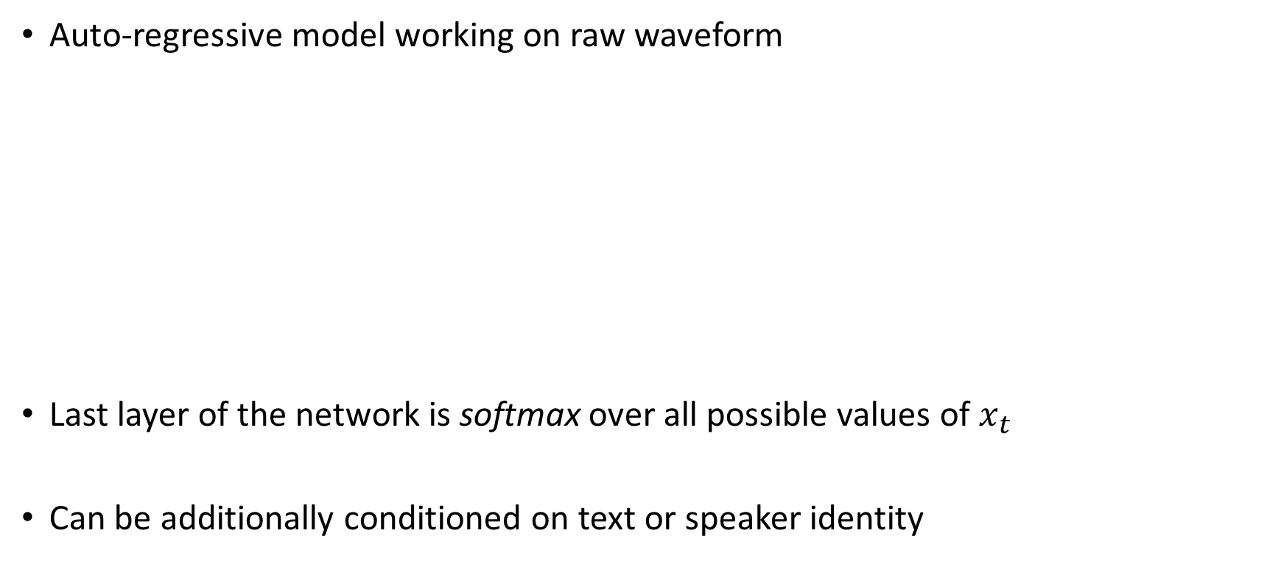
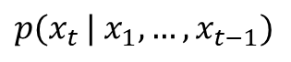
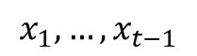
Wavenet
Auto-regressive model working on raw waveform
Last layer of the network is softmax over all possible values of $x_{t}$
Can be additionally conditioned on text or speaker identity
$$p\left(x\right)=\prod_{t=1}^{T}{p\left(x_{t}\right|x_{1},…, x_{t−1})=p(x_{1})p(x_{2}\left|x_{1}\right)p\left(x_{3}\right|x_{2}, x_{1}) p(x_{4}\left| x_{3},x_{2},x_{1}\right)…}$$
Neural network
$$x_{1},…, x_{t−1}$$
$${p(x}_{t }| x_{1}, …, x_{t−1})$$

Slide 39
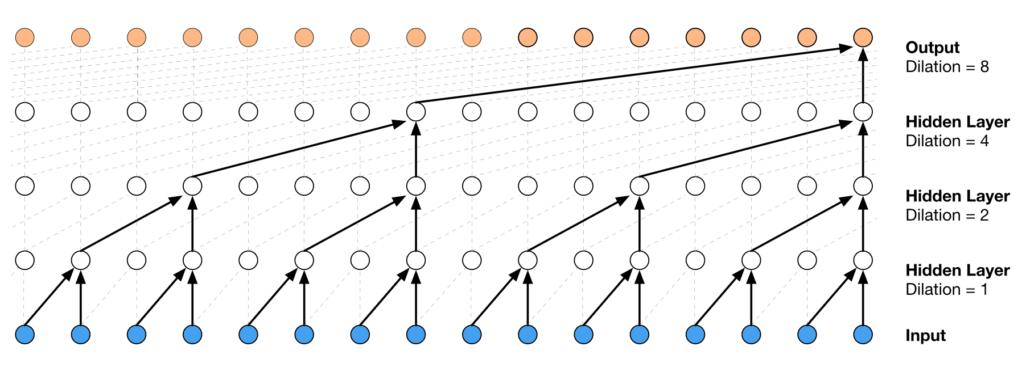
Wavenet architecture

Slide 40

Wavenet architecture

Slide 41
Wavenet examples
Conditioned on text
Not conditioned on text
Conditioning on different speakers
Generating music
https://deepmind.com/blog/article/wavenet-generative-model-raw-audio

Slide 42
Other tasks

Slide 43
Voice conversion
Voice conversion
source
target
converted
http://www.kecl.ntt.co.jp/people/kameoka.hirokazu/Demos/stargan-vc
Commonly used techniques
Auto-encoders, adversarial training, ASR-TTS

Slide 44
Speech coding
Coding
transmission
Decoding
…
Compression of audio signals containing speech
Application: mobile telephony
Can make use of: Redundancies in speech signal
Properties of human hearing
Techniques: Linear prediction
Quantization
Potential of neural networks

Slide 45
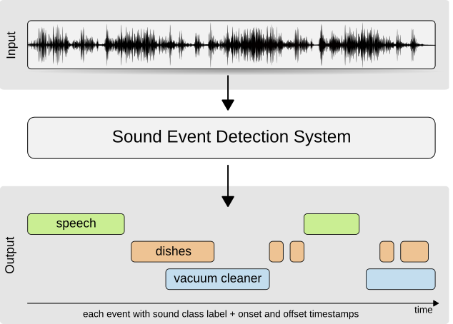
Sound event detection
Techniques: mostly neural networks, weakly supervised training strategies
http://dcase.community/challenge2019/task-sound-event-detection-in-domestic-environments

Slide 46
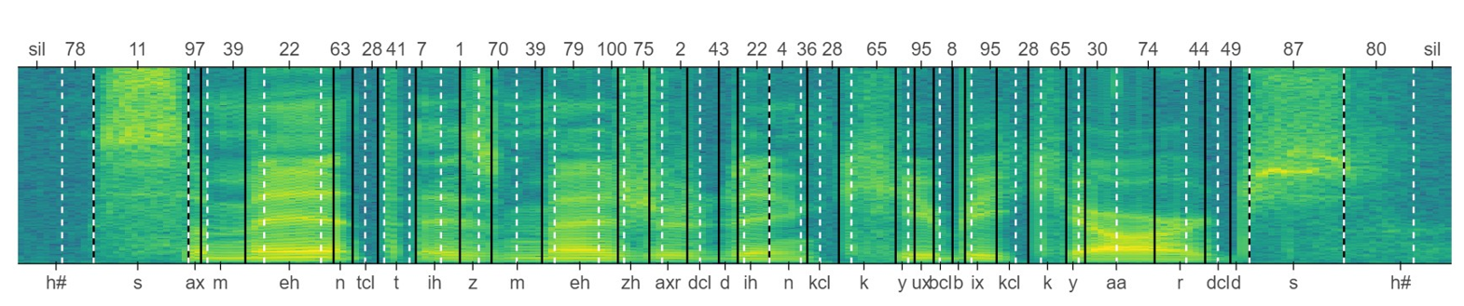
Acoustic unit discovery
Task: Discover (phone-like) units from speech signal
Techniques: hidden Markov models, variational auto-encoders
Applications: tool for linguists studying new languages
understanding how humans acquire language

